Slide 1
Data Storage Structures

Slide 2
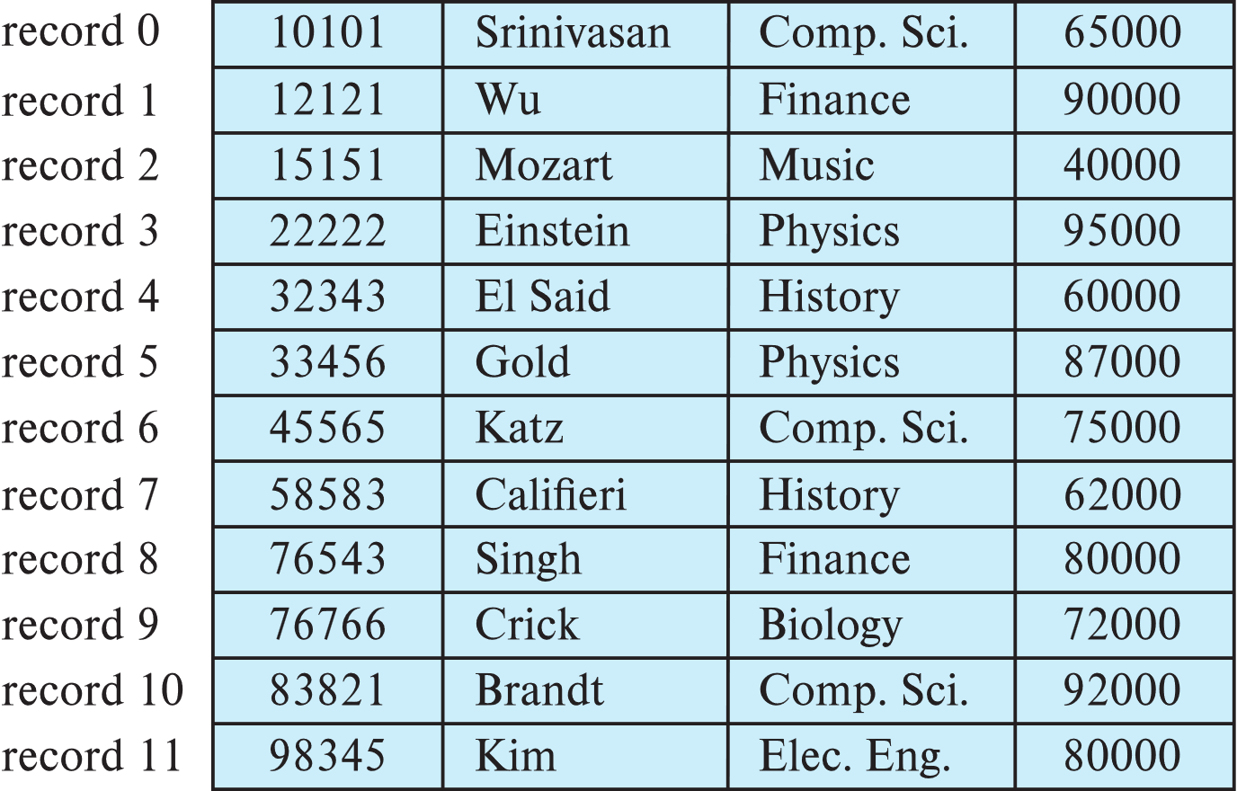
File Organization
Instructor relation
The database is stored as a collection of files.
Each file is a sequence of records.
A record is a sequence of fields.
One approach
Assume record size is fixed
Each file has records of one particular type only
Different files are used for different relations
This case is easiest to implement; will consider variable length records later
We assume that records are smaller than a disk block
ID | Name | Dept. | Salary

Slide 3
Fixed-Length Records
Simple approach:
Store record i starting from byte n ∗ (i – 1), where n is the size of each record.
Record access is simple but records may cross blocks (???)
Modification: do not allow records to cross block boundaries
Searching a record:
Record size = 70 byte. The disk head position is 00 (track 0 and sector 0).
Find the location of 5th record.
ID | Name | Dept. | Salary
Record location
= 70 * (5-1)
= 280

Slide 4
Fixed-Length Records (Query Processing)
Simple approach:
Store record i starting from byte n ∗ (i – 1), where n is the size of each record.
Record access is simple but records may cross blocks (???)
Modification: do not allow records to cross block boundaries
Example
Given block size = 512bytes. Record size = 100 bytes.
Select * from instructor where id = 76766
Current head position in track 1000 and instructor location is track 0 and sector 0.
Explain how record crosses block?
What is the block number of id = 76766?
Explain how this query will be executed?
Find the number of seek and block transfer for this query.
ID | Name | Dept. | Salary

Slide 5
Fixed-Length Records (Query Processing)
Simple approach:
Store record i starting from byte n ∗ (i – 1), where n is the size of each record.
Record access is simple but records may cross blocks (???)
Modification: do not allow records to cross block boundaries
Question w1-5
Given block size = 350bytes. Record size = 100 bytes.
Select * from instructor where id = 98345
Current head position in track 1000 and instructor location is track 0 and sector 0.
Records does not crosses block boundary.
What is the block number of id = 76766?
Explain how this query will be executed?
Find the number of block transfer and seek for this query.
ID | Name | Dept. | Salary

Slide 6
Fixed-Length Records (Deletion of Records)
Deletion of record i: alternatives:
move records i + 1, . . ., n to i, . . . , n – 1
move record n to i
do not move records, but link all free records on a free list
ID | Name | Dept. | Salary
Example
Delete from instructor where id = 22222
Explain how the deletion will be performed using alternative a?

Slide 7
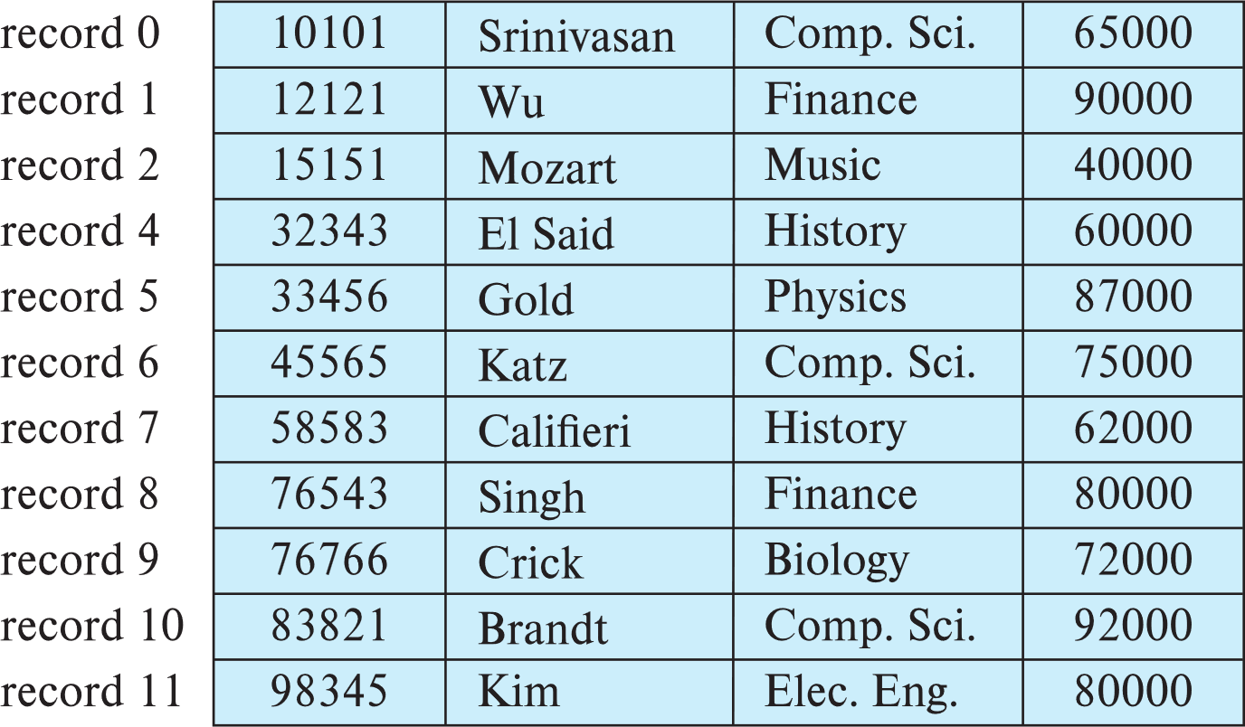
Fixed-Length Records (Deletion of Records)
Deletion of record i: alternatives:
move records i + 1, . . ., n to i, . . . , n – 1
move record n to i
do not move records, but link all free records on a free list
ID | Name | Dept. | Salary
Example
Delete from instructor where id = 22222
Explain how the deletion will be performed using alternative a?

Slide 8
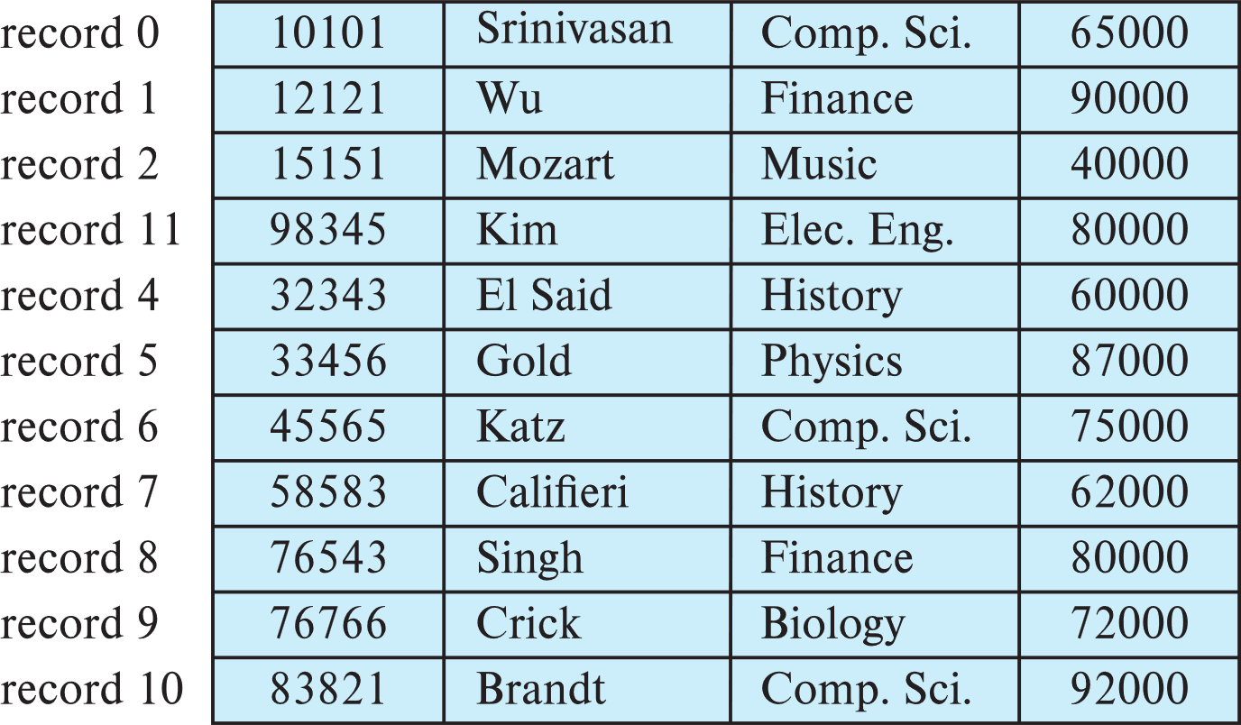
Fixed-Length Records (Deletion of Records)
Deletion of record i: alternatives:
move records i + 1, . . ., n to i, . . . , n – 1
move record n to i
do not move records, but link all free records on a free list
ID | Name | Dept. | Salary
Example
Delete from instructor where id = 22222
Explain how the deletion will be performed using alternative b?

Slide 9
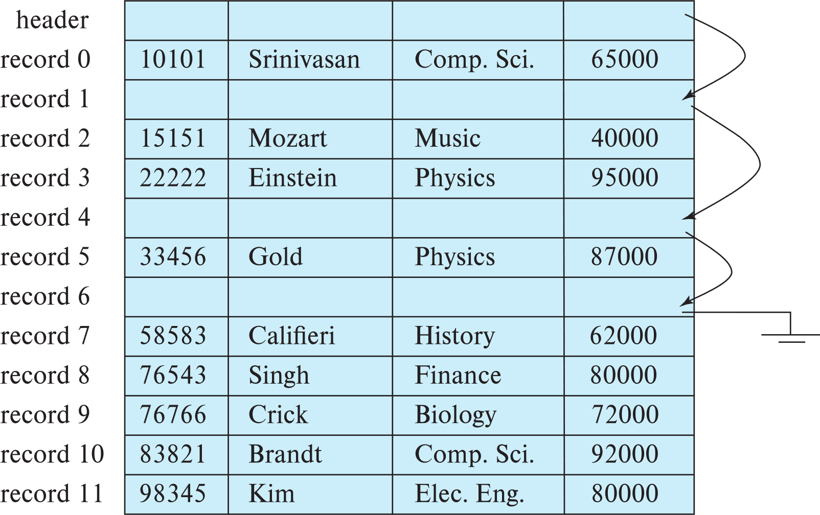
Fixed-Length Records (Deletion of Records)
Deletion of record i: alternatives:
move records i + 1, . . ., n to i, . . . , n – 1
move record n to i
do not move records, but link all free records on a free list
Example
Delete from instructor where id = 12121 (record 1)
Delete from instructor where id = 32343 (record 4)
Delete from instructor where id = 45565 (record 6)
Explain how the deletion will be performed using alternative c?
ID | Name | Dept. | Salary

Slide 10
Fixed-Length Records (Deletion of Records)
Deletion of record i: alternatives:
move records i + 1, . . ., n to i, . . . , n – 1
move record n to i
do not move records, but link all free records on a free list
Discussion
Implementation of fixed length record file management system
Defining classes and methods
Storage of a relation as per the defined classes
ID | Name | Dept. | Salary

Slide 11
Variable-Length Records
Variable-length records arise in database systems in several ways:
Storage of multiple record types in a file
Example: student (id char(10), name char(30), address char(50), CGPA number(3,2), year-admit number(4)) and takes (id char(10), course-id char(20), level char(1), term char(1)) are stored in same file.
Record types that allow variable lengths for one or more fields such as strings (varchar)
Example: student (id char(10), name varchar(30), address varchar(50), CGPA number(3,2), year-admit number(4))
c. Record types that allow repeating fields (used in some older data models).

Slide 12
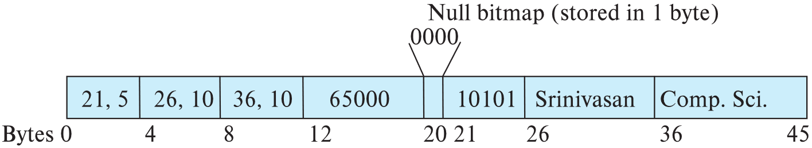

Variable-Length Records
Implementation
Attributes are stored in order
Variable length attributes represented by fixed size (offset, length), with actual data stored after all fixed length attributes
Null values represented by null-value bitmap
Example: Implement the variable length record for the relation:
instructor (id char(5), name varchar2(30), dept-name varchar2(20), salary number(8)) for the following record:

Slide 13
Variable-Length Records
Question w1-6: Implement the variable length record for the relation:
instructor (id char(5), name varchar2(30), dept-name varchar2(20), salary number(8)) for the following records:

Slide 14
Variable-Length Records: Slotted Page Structure
Slotted page header contains:
number of record entries
end of free space in the block
location and size of each record
Records can be moved around within a page to keep them contiguous with no empty space between them; entry in the header must be updated.
Pointers should not point directly to record — instead they should point to the entry for the record in header.

Slide 15
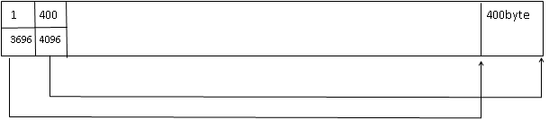
Example: Given the relational schema as follows:
Student (id, NID, name, f-name, f-NID, m-name, m-NID, DOB, cgpa, tot-cred, uni-id, uni-name, uni-street, uni-city, house-no, street, city, d-no, d-name, building)
Takes (id, course-no, semester, year, grade)
Course (course-no, title, credit, pre-req)
The record size for student, takes and course are 400, 100 and 80 bytes respectively. The block size is 4 KB. Show the slotted page structure after storage of one tuple (record) from each relation as per the above mentioned order.
Step 1: insert student record of 400 byte into the block of 4000byte.

Slide 16
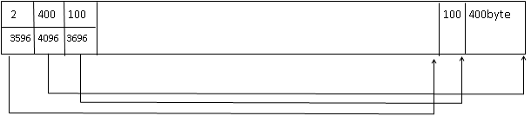
Step 2: insert takes record of 100 byte into the block of 4000byte.
Question w2-3:
Insert course record of 80 byte into the block of 4000byte.
Explain the deletion of a record for different cases (last record, first record, any record in betewen first and last record)

Slide 17
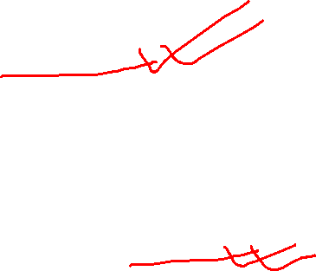
Storing Large Objects
E.g., blob/clob types
Some DBMS: Records must be smaller than blocks
Alternatives:
Store as files in file systems
Store as files managed by database
Break into pieces and store in multiple tuples in separate relation
PostgreSQL TOAST

Slide 18
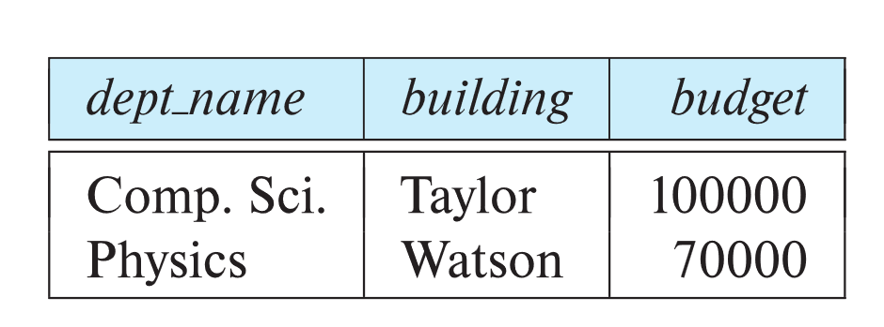
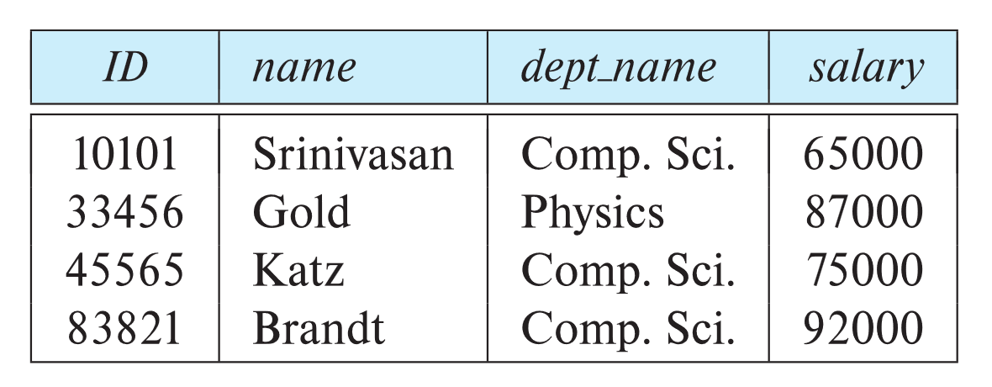
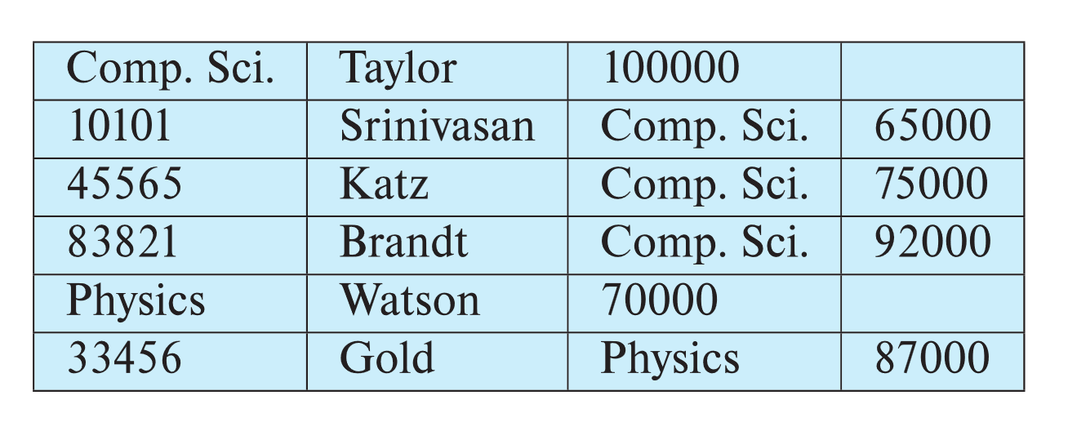
Multitable Clustering File Organization
Store several relations in one file using a multitable clustering file organization
SELECT ID, building
FROM instructor i, department d
WHERE i.dept_name = d.dept_name
And dept_name = ‘Comp. Sci.’
department
instructor
Example
Explain how the above query is processed using
Single table file organization
Multi-table file organization
multitable clustering
of department and
instructor

Slide 19
Multitable Clustering File Organization (cont.)
good for queries involving department ⨝ instructor, and for queries involving one single department and its instructors
bad for queries involving only department
results in variable size records
Can add pointer chains to link records of a particular relation

Slide 20
Data Dictionary Storage
The Data dictionary (also called system catalog) stores metadata; that is, data about data, such as
Information about relations
names of relations
names, types and lengths of attributes of each relation
names and definitions of views
integrity constraints

Slide 21
Data Dictionary Storage
The Data dictionary (also called system catalog) stores metadata; that is, data about data, such as
User and accounting information, including passwords
Statistical and descriptive data
number of tuples in each relation
Physical file organization information
How relation is stored (sequential/hash/…)
Physical location of relation

Slide 22
Relational Representation of System Metadata
Relational representation on disk
Specialized data structures designed for efficient access, in memory
Question w2-4: In DBMS,
you cannot create two tables or two views with the same name;
two attributes or two indices with the same name for the same table.
How are these implemented?

Slide 23
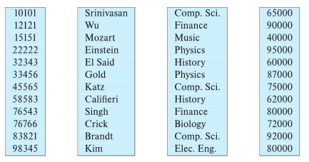
Column-Oriented Storage
Also known as columnar representation
Store each attribute of a relation separately
Example

Slide 24
Columnar Representation
Benefits:
Reduced IO if only some attributes are accessed (How?)
SELECT id, salary FROM instructor
Improved CPU cache performance (How?)
Improved compression (How?)
Vector processing on modern CPU architectures (Parallel CPU operation on multiple elements of an array.

Slide 25
Columnar Representation
Drawbacks
Cost of tuple reconstruction from columnar representation (What?)
Select * from instructor where id = 32343
How will this query be executed using columnar storage?
Search id column and find 32343 and the tuple-id (here it is 5)
Query result = 32343, 5th value of name column, 5th value of dept-name column, 5th value of salary column

Slide 26

Columnar Representation
Drawbacks
Cost of tuple deletion and update (What?)
Delete from instructor where dept-name = ‘History’
Find tuple-id of ‘History’ from dept-name column ( tuple-id = 5, 8)
Delete tuple-id = 5, 8 from all 4 columns
Similar is update

Slide 27
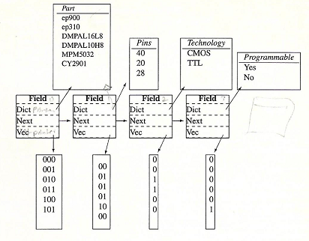
Compressed Columnar Representation

Slide 28
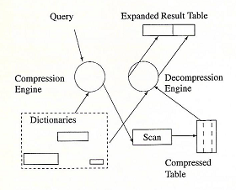
Query Processing in Compressed Columnar Representation

Slide 29
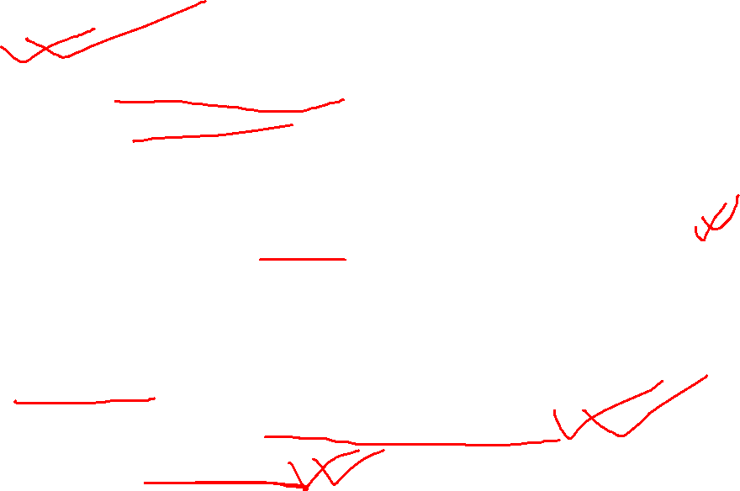
Columnar Representation
Advantages
Storage efficient
Query efficient because query can be processed in compressed form with a very low decompression overhead
Drawbacks
Cost of decompression (What?)
Columns are stored in compressed format. Every query requires decompression
Conclusions
Columnar representation found to be more efficient for decision support than row-oriented representation (Why?)
Data Warehouse (DW) is used for decision support
DW uses only few attributes, no update and only data insert.
So column storage is efficient

Slide 30

Columnar Representation
Traditional row-oriented representation preferable for transaction processing (Why?)
Transaction processing requires frequent update and deletion
Some databases support both representations
Called hybrid row/column stores

Slide 31
Columnar File Representation
ORC (Optimized Row Columnar) and Parquet: file formats with columnar storage inside file
Very popular for big-data applications
Orc file format
ORC and Parquet are columnar file representations used in many big-data processing applications.
In ORC, a row-oriented representation is converted to column-oriented representation as follows: A sequence of tuples occupying several hundred megabytes is broken up into a columnar representation called a stripe.
An ORC file contains several such stripes, with each stripe occupying around 250 megabytes

Slide 32
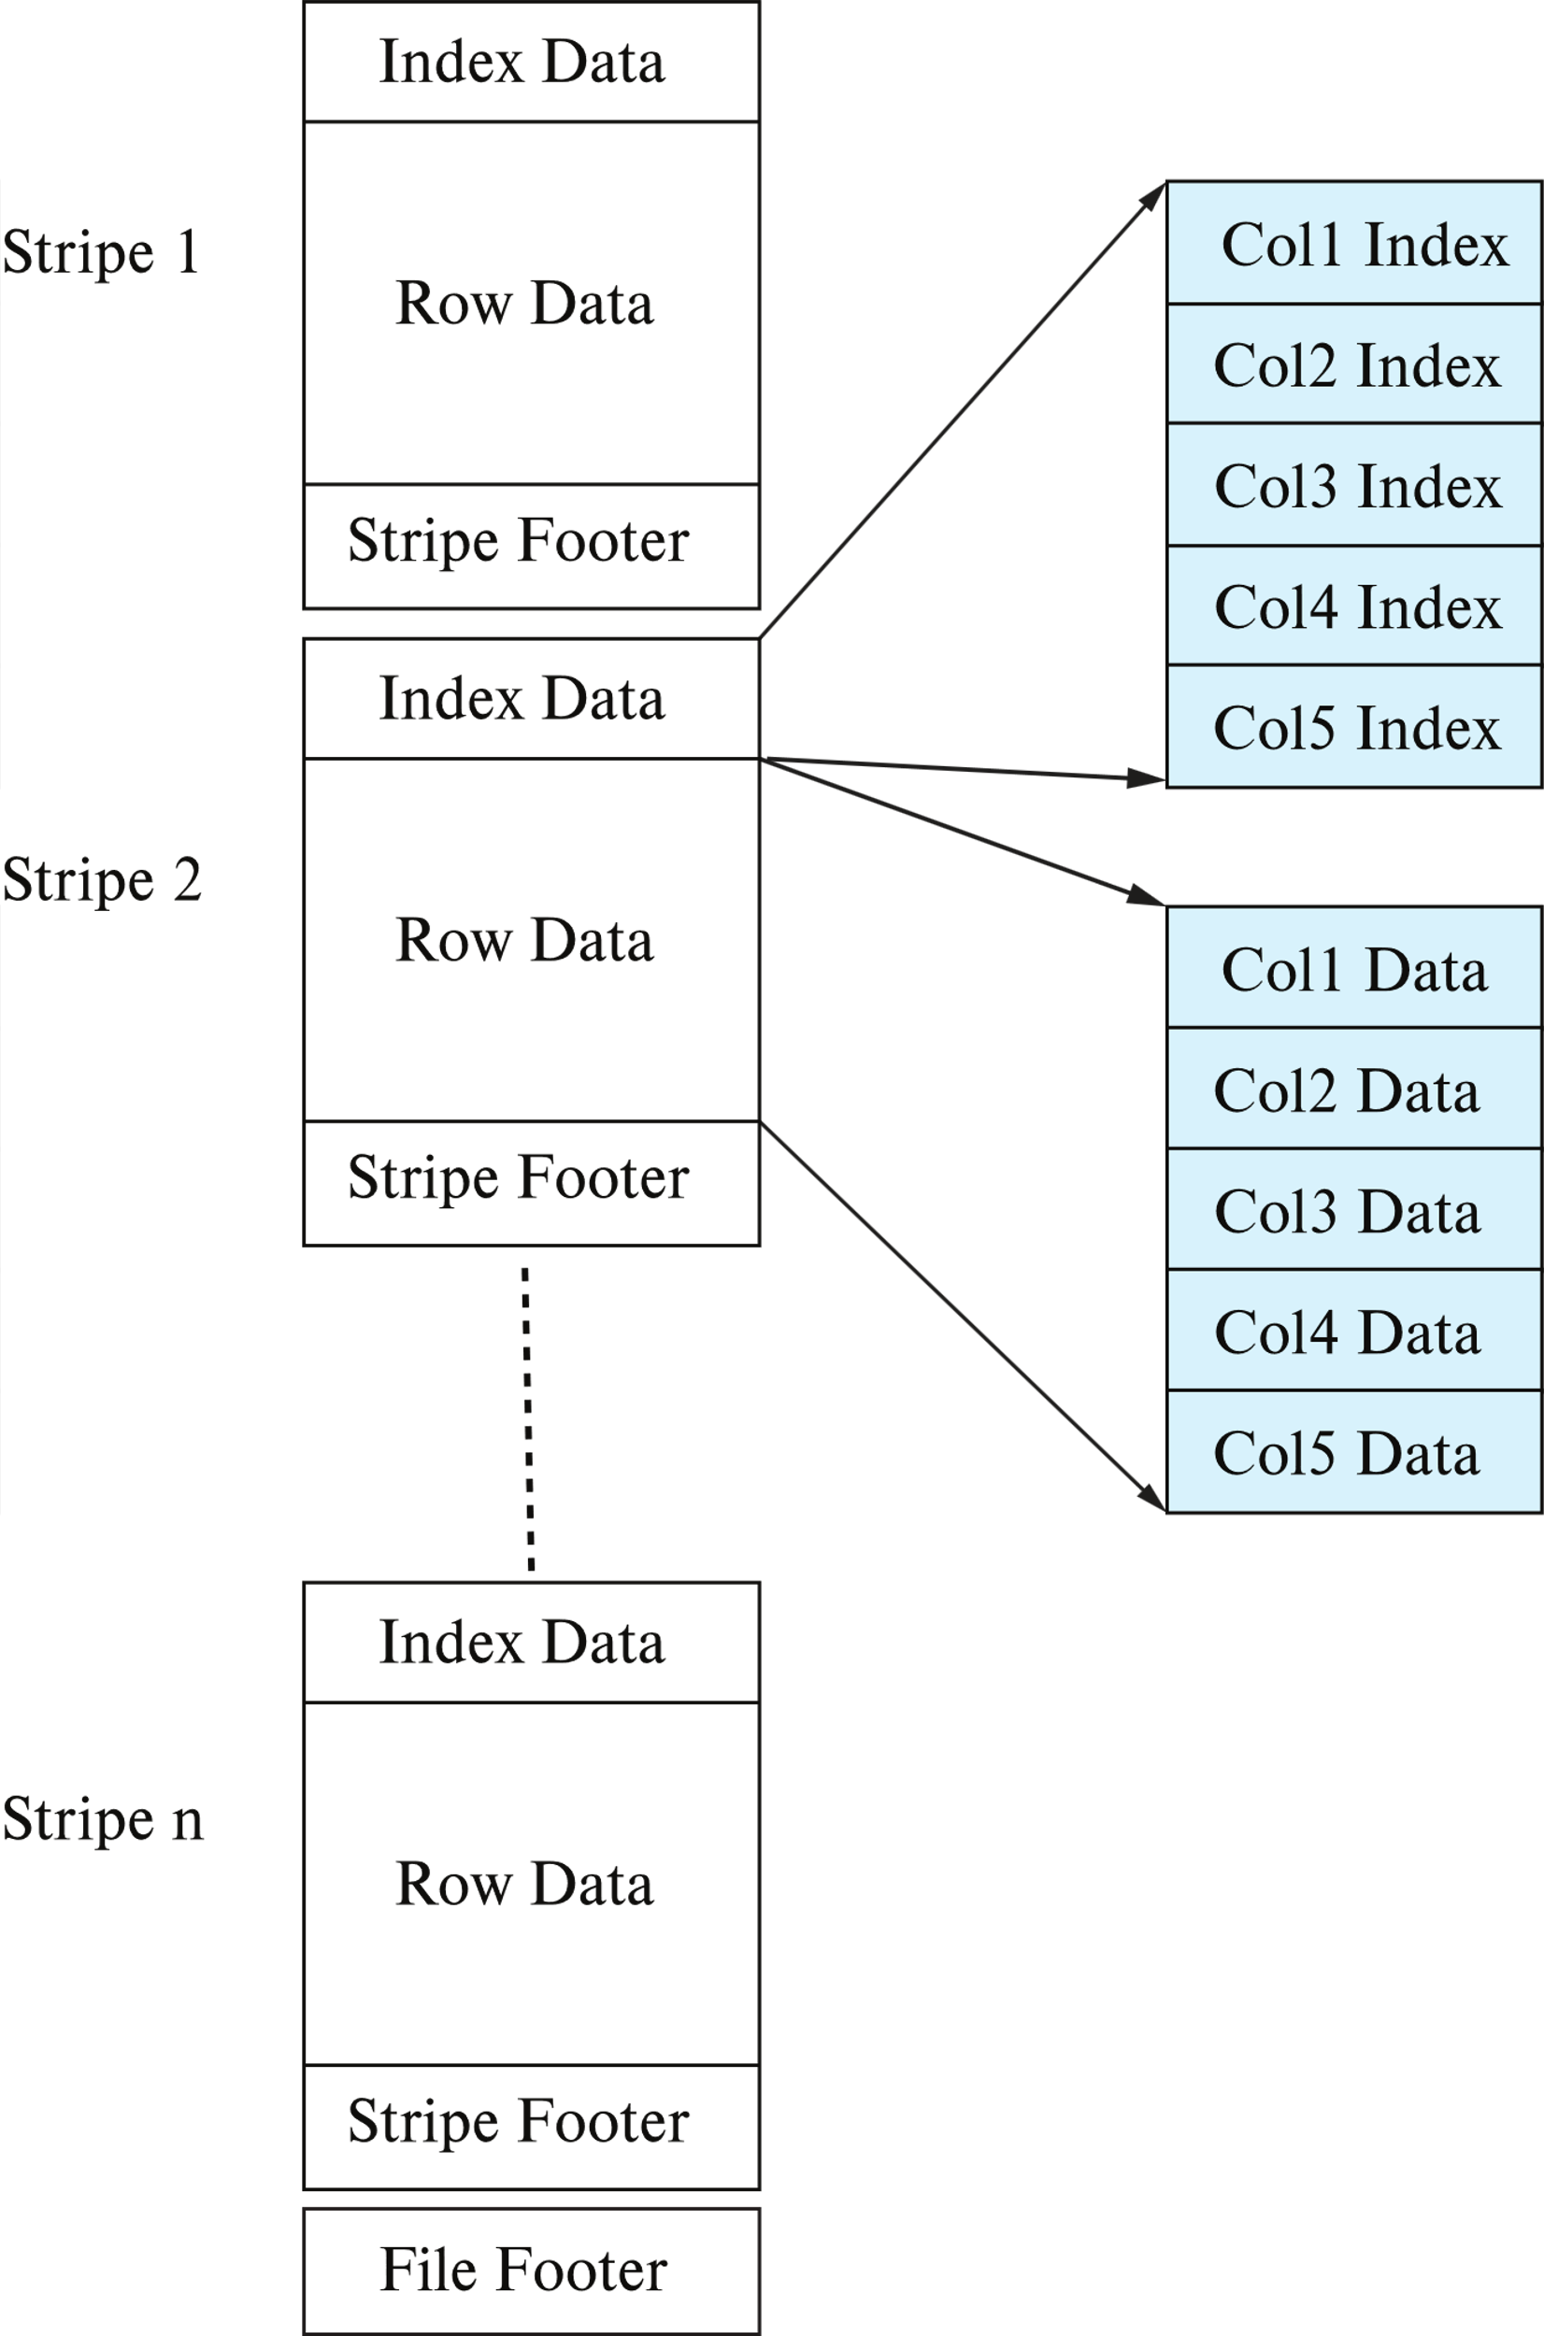
Columnar File Representation
ORC (Optimized Row Columnar) and Parquet: file formats with columnar storage inside file
Very popular for big-data applications
Orc file format shown on right:

Slide 33
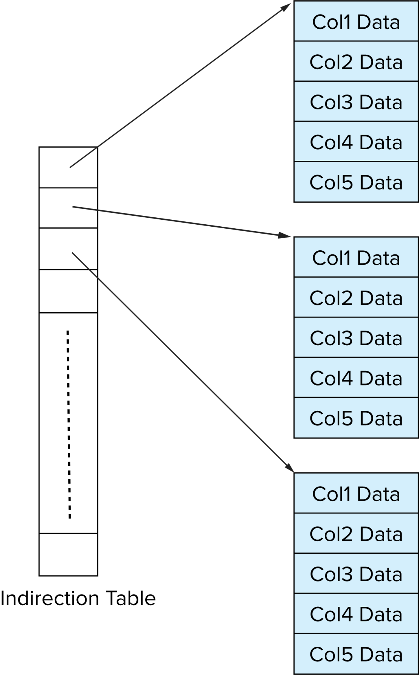
Storage Organization in Main-Memory Databases
Can store records directly in memory without a buffer manager
Column-oriented storage can be used in-memory for decision support applications
Compression reduces memory requirement
V1
V2
V3
The values of V1, V2, V3, V4 are 1000, 2000, 3000, 4000 respectively.
Find 2500th tuple?

